Slide 1

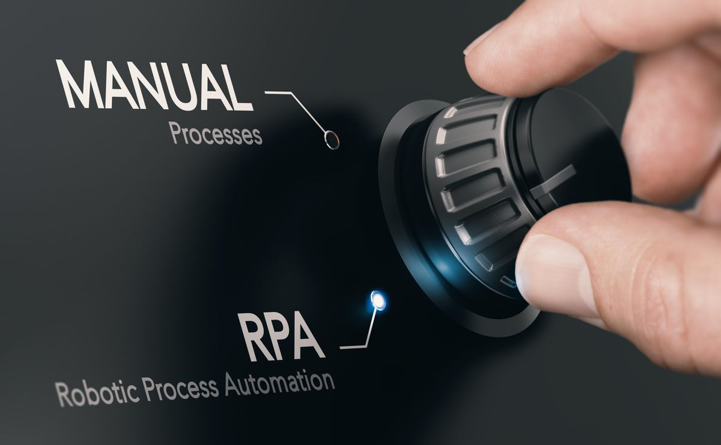
Department of Computer Science and
Engineering
RPA Design and Development
(CSE552)-(3-0-0-0)
Dr. Bheemappa H
Dept. of CSE
RIT

Slide 2
UNIT I
PROGRAMMING BASICS
Software Application and Software Development Life
AUTOMATION AND RPA:
Introduction to RPA
Automation vs RPA,
Process and Flowchart ,
RPA Programming Constructs,
Robots in RPA
Introduction to Robots,
Types of Robots,
Benefits and Implementation of RPA

Slide 3
Automation
Automation is the technology by which a process or procedure is performed with minimal human assistance.
Operating equipment such as machinery, processes in factories, boilers.
Switching on telephone networks, steering and stabilization of ships, aircraft and
Automated Machine
Process or Procedure
Process or Procedure
Machine
control
systems
Machine
End
End
Start
Start
Worker
Periodic Worker
Fig: 1.a General execution of process
Fig: 1.b Execution of process using
Automation

Slide 4

Journey from Automation to RPA
01
Screen Scraping
02
Workflow Automation and Management Tools
03
Artificial Intelligence
Notes:
How did automation become RPA?
Three technological advancements that helped in evolution of automation to RPA are: Screen Scrapping, Work Flow Automation, and Artificial Intelligence.
Screen Scraping software enables robots to interact with different user interface elements and documents, such as .pdf files, to extract data for further processing. The extraction of data is facilitated by OCR engines and Computer Vision libraries.
Workflow Automation and Management Tools provide visual representations of business or mechanical processes, minimize the human intervention required in their execution, and eliminate the redundant steps, thus increasing their efficiency.
Artificial Intelligence consists of technologies such as Machine Learning, Cognitive Engines, and Natural Language Processing. The tasks that were previously dependent on humans for their judgement and decision-making ability, can now be done by AI. E.g. financial planning and fraud detection.
Additional Notes*
With the advancements in technology, there are continuous improvements in the automating approach as well. To make automation more effective, many advanced technology are being integrated with the existing tools making them more reliable and consistent .

Slide 5
Introduction to RPA
What is RPA?
Robotic process automation (RPA) is the process of automating process or operations using robots (bots) in order to reduce human intervention
Imitates human actions.
Interact with a computer application.
Accomplishing the automation of repetitive and rule-based processes.
Perform a sequence of steps without any human intervention
With the evolution of technology, the concept of automation improved and evolved as Robotics Process Automation.
Robotic: Represents a machine which mimics human actions Process: A step-by-step sequence which can complete a task Automation: Without any human intervention
RPA

Slide 6
Characteristics of RPA
User-Friendly:. RPA projects require less IT skills and less investment. Eventually, the automation is lowered at a substantial rate.
No programming code required: RPA doesn’t require programming skills. Employees with any subject expertise can be trained to automate RPA tools instantly. flowchart designer to graphically link, drag and drop icons to represent steps in a process.
Non- Disruptive: RPA avoids complexity and risk. The software robots access to end user’s systems via a controlled user interface, hence reducing the necessity of underlying systems programming.

Slide 7
Advantages of RPA
The advantages of adopting an RPA solution into business are:
Reduced cost of process execution
Improved accuracy
Easier scaling
Increased execution speed
Improved compliance and governance
Notes:
The implementation of an RPA solution brings several benefits. Some of the main advantages of businesses adopting an RPA solution are as follows:
Increased execution speed:
RPA robots are much quicker and efficient than a human operator.
Improved accuracy:
RPA leads to improved accuracy as the designed robot works on the given instruction.
Improved compliance and governance:
RPA solutions have already been adopted to ensure regulatory compliance, especially in the banking sector. Since the Robot Login details are secure and unique, the activity carried out is well controlled and supervised leading to improved regulatory compliance. This creates transparency and allows the user to recognize any issue or defect easily.
Reduced cost of process execution:
The work capacity of robots is superior to that of human workers. When an RPA solution is implemented, the task execution rate is considerably increased, and the corresponding costs are decreased. A robot can work 24*7, there is no time constraint. This increases the productivity time and improves the output.
Easier scaling:
The amount of work involved in a process can vary, as unexpected changes are likely to occur in most business environments. If an RPA solution is used, companies can easily adapt by scaling the solution up or down, depending on the requirements, regardless of how volatile they might turn out to be.
Additional Notes*
RPA is highly scalable, up as well as down. Whether one requires an increase or reduction in the virtual workforce, robots can be quickly deployed at zero or minimum costs while maintaining consistency in the quality of work.

Slide 8
Robotic Process Automation Tools
RPA Blue Prism
UiPath
Automation Anywhere
Kofax Kapow
NICE

Slide 9
Automation vs RPA
These below features will help explore the characteristics of Automation and RPA:
Regular Automation | RPA
The user should have a deep understanding of the target application. | As long as RPA knows the right actions to perform, the user needn’t bother about the complexity of the underlying application.
The method by which we improve the existing process and improve the efficiency is called automation | The advanced form of automation involving latest technology like screen scraping , workflow and Artificial intelligence
Regular Automation is completely dependent on coding and relies on methods to integrate different systems. | RPA involves little or no coding.
Automation requires the invention of a technology or a software program. | In RPA, we don’t invent anything new; instead, we train the technology to perform the tasks that are done manually.
For example, when we had to automate the process of calculating numbers, we invented a calculator. Example: Heavy Industries like: Automobile, Manufacturing etc. | RPA can be used to enter the numbers automatically on a calculator and do the calculations. Example: Finance, Healthcare, Insurance etc.

Slide 10
Process
A process is defined as a series of steps, activities, and decisions involved in the way work is accomplished.
There are typically two ways to represent a process:
As a sequence, where actions come one after the other
As a flowchart, where there are multiple decision points and logical branches
The process chosen for automation is split into simple actions and mapped in the RPA tool.
The RPA developer analyzes and configures the mapped process by introducing decision points, variables, pre-defined operations, and other types of elements available in the RPA tool.
Once the logic is replicated in the workflow, the process is ready for automation.
Notes:
Process :
The process is represented either as a succession of steps, or as a flowchart, where the decision points are more easily represented.
In its simplest form, RPA replicates the actions that were presented by the user using the graphical user interface. The RPA tool tries to draw the process to be able to translate it into small steps and understand its underlying logic.
Very simple processes can be replicated as such, without other interventions. However, in case of complex business processes, an RPA developer needs to configure the workflow in order to make business decisions or do complex operations. RPA involves the use of robotic control flow to capture the logic and decisions of a business process. RPA tools offer plenty of activities and technologies to match the needs and complexity of real-life processes.

Slide 11
RPA Programming Constructs
Programming constructs are the backbone of any programming language. Some important programming constructs are:
S
S
R
C
D
Sequence
Selection
Repetition
Control Statements
Data Types
Notes:
Programming constructs form an integral part of any coding. The Programming constructs are the backbone and form the foundation of any programming language. They are the building blocks of programming. The term construct in general means “invent or make up.” In programming, constructs are defined as the logical and structural approach required to define the underlying principle of programming.
There are important programming constructs that we generally utilize to make the programming logical and structural.
Sequence: The term sequence denotes the first step or the first block of programming. It indicates the next process or step that needs to be taken.
Selection: Once the programmer has constructed the sequence, it is important to select a course of action on the basis of the given conditions. Hence, we can say that selection allow a programmer to choose among the various alternatives that best suit the requirement .
Repetition: A repetition construct causes a group of one or more program statements to be invoked or applied repeatedly until some end condition is met.
Control Statements: These are common ways of controlling the flow of logic, operations, functions in a program/algorithm. These act like the ‘plumbing’ of a program or algorithm. Examples: ‘if’ statements, ‘while’ or ‘for each’ loops
Data Types: Data types are used to specify any kind of expected class of information. Common data types are Integer (0, 1, 2), Float (0.5, 1.234, 20.3) and Character (‘a’, ’b’, ‘c’). String are one or more characters (“Tom”), Boolean (holding either a ‘True’ or ‘False’ value). Each language can define its own data types.

Slide 12
RPA Programming Constructs
Some important programming constructs are:
S
V
I/0
R
O
Scope
Validation
Input/output
Risk/Error Handling
Optical Character Recognition (OCR)
Notes:
Scope: A scope is a specific context that is relevant to the program at any particular point in time. The scope has to be very clear and defined for the success of the project.
Validation: At any step in a process or automation, there might need for validation. It is defined as the act of verifying the qualities of a process to ensure that they are correct. Validating data in a process is often a critical requirement before execution. Common examples are making sure that:
The data types match what was expected
The types of values (say Integers) are within a certain threshold (0-100).
Input /Output: For each piece of automation or algorithm, there might be an expected Input and/or Output. Any information or data that is sent to a computer for processing is considered input. Input is the data at the entry point of the automation. Any information that has been processed by and sent out from a computer or other electronic device is considered output. Output is the data being returned at the end of the automation.
Risk/Error Handling: Every process should be evaluated for risk. This generally includes looking at every step of the process that can fail, or result in a failure later on in the process. This also involves quantifying how a possible failure could harm the overall system or business. By identifying all possible risks, error handling can be implemented to mitigate or completely reduce that risk. Error handling makes programming effective and more reliable, so that the activities executed by the program are useful and have zero impact on the productivity. No machine can be 100% efficient (ideal case) but we should try to minimize the error .
Optical Character Recognition (OCR): OCR refers to the software that analyzes images for alphanumeric characters. It processes a digital image by locating and identifying characters such as letters, numbers, and symbols.

Slide 13
Processes Best Suited for RPA
Processes that are simple, structured and can be easily mimicked by a machine are best suited for RPA.
Repetitive Processes
Processes that are done iteratively and are very similar
.
Rule-based Processes
Processes that can be translated into a set of rules
Structured Processes
Processes that are well-defined or structured
Notes:
With increasing demand of implementation of RPA, it is very important to understand the limitation and scope of these tools when we talk about their contribution.
Processes that are simple, structured and can be easily mimicked by a machine are best suited for RPA.
They are repetitive, rule based and structured processes.
Repetitive: Processes that are done iteratively and are very similar in each iteration are good candidates. Automation speeds up the execution of those processes resulting in increased productivity.
Rule-based: If the way of handling a specific process does not undergo significant changes with each iteration, it can easily be translated into a set of rules to be followed by RPA robots. A rule-based process is therefore a great candidate for automation.
Structured: Are the aspects of the process well-defined or structured? If that is the case, the automation of the process is easy to perform. The consistency and accuracy of robots is greater than a human worker could accomplish. That means they are less prone to error. Moreover, robots can be built to report all relevant data around their processes immediately, so it is very easy to keep track of their activity.
Processes involving complex data require human intelligence. Research analytics and follow up are still considered a challenge for RPA.

Slide 14
Robots in RPA
A robot is a software that can execute workflows containing multiple steps.
It can mimic human actions such as type, click and read data
It can perform complex calculations and decision making
It can log into applications, move files/folders, and copy paste data
Notes:
A robot is a software which can be taught how to execute workflows that contain multiple steps in various applications.
These software robots also perform complex calculations and decision making on the basis of data and predefined rules.
RPA robot interacts with applications. Once trained, these robot perform the tasks with precision.
Additional Notes*
The software robots are designed for improving efficiency and saving time.
They are versatile and work 24*7.
They are efficient and are cost effective as they save resources .
The software robot can perform task such as loop, control, pathfinding, data filtering, and sharing data.

Slide 15
Types of RPA Robots
In RPA, robots are categorized on the basis of manual intervention required.
Attended
Unattended
Robots that collaborate with a human worker.
Standalone robots that perform workflows.
Business Unit
Business Unit
Business Unit
COE
COE
Business Unit
Business Unit
Business Unit
Notes:
In RPA, robots are categorized as Attended and Unattended Robot on the basis of whether or not they require manual intervention.
Attended robots collaborate with human workers on business activities, speeding up repetitive front-office tasks. They reside on the workstation of the human worker and are perfect collaborators in service desk, helpdesk, and call center activities.
They work in the background and ensure high productivity and low handling times, while the human workers can continue to carry out their tasks unhindered.
They need manual intervention and hence they are not fully automated. Manual intervention is required where human activity or intelligence is required for the further execution or completing the task.
Unattended robots can operate without human touch on any variety of back-office activities. They can run in both physical and virtual environments. They can also be scheduled to start and stop at any time as per the business requirements.
The unattended robots are maintained and guided remotely by server. These robots are designed to work end to end without any interventions.

Slide 16
Types of Robots
In UiPath, Robots are of two types:
Attended Robots
Unattended Robots
Operate with human intervention
Triggered by user events
Operate without human intervention
Work standalone in virtual environment
Notes:
A robot executes the workflows and instructions sent locally or via Orchestrator.
In UiPath, there are two types of robots:
Attended Robots: triggered by user events, and operate alongside a human, on the same workstation.
Unattended Robots: run unattended in virtual environments and can automate any number of processes.

Slide 17
Attended Robots
What do they do?
Collaborate with human worker for small and repetitive tasks
How do they work?
Triggered by users or specific user events
Where do they run?
On the same machine on which the user performs the day-to-day tasks
Notes:
Attended Robots:
These robots collaborate with human workers on business activities and speed up the repetitive front-office tasks.
They reside on the workstation of the human worker and are perfect collaborators in service desk, helpdesk and call center activities.
These robots work in the background and ensure high productivity and low handling times. While the human workers can continue to carry out their tasks unhindered.
They are best suited for use with smaller, more fragmented tasks.
Example: The submission of an expense report. In this task, an Attended Robot is deployed, and the human user provides the login credentials to the system. The Robot then fills in the requisite information and submits the expense report on the behalf of the user by attaching any required details or items.

Slide 18
Unattended Robots
What do they do?
Run long processes or automations without human interaction
How do they work?
Controlled through Orchestrator
Where do they run?
Any machine connected to Orchestrator
Notes:
Unattended Robots can:
Operate without human intervention on any variety of back-office activities. They can run in both physical and virtual environments.
Be scheduled to start (and stop) at any time as per the business requirements. They are maintained and guided remotely by the server. These robots are designed to work end to end without any interventions.
Automate any number of processes efficiently. Tasks to unattended robots are assigned through Orchestrator. They are best suited for complex and highly repetitive tasks.
Example: In the example of submission of expense report, the task of approval of expense reports can be executed using Unattended Robots. Without any human intervention, the Robot can login to the system and process the expense report submitted for approval. If the report matches a defined rule (set by the administrator), the Robot automatically approves it. As there is no human interaction, the possibility of report approval as per the user’s wish is eliminated and the system operates purely based on the rules.

Slide 19
Implementation of RPA
RPA has been implemented in various business areas to perform repetitive and time-consuming tasks.
Finance and Accounting
Supply Chain
HR Services
IT Services
Process Examples:
Procurement to pay
Order to cash
Vendor management
Process Examples:
Inventory Management
Invoice/Contract Management
Work Order Management
Process Examples:
Recruitment
Payroll
Personnel administration
Process Examples:
Password reset
Account unlock
Chatbot integration
Notes:
Let’s take a look at the industries and processes that have been improved with the help of RPA.
HR Services involve a variety of repetitive processes, which are highly-standardized through different template forms. These processes take place regularly and with high frequency. Some examples of repetitive processes include recruitment, data entry, payroll, personnel administration. We can infer that repetitive, highly-standardized, regular, and frequent processes are the first ones to be considered when deciding what should be automated.
Finance and Accounting is an area where a significant amount of processes have already been automated by many companies. Processes such as Procurement to Pay, Order to Cash, Vendor Management, and many others have proven ideal candidates for automation, bringing important benefits such as cost savings, error reduction, and faster processing to the business.
IT Services is another department where RPA can be leveraged. Typical IT support scenarios, such as password reset and account unlock, can easily be automated. Automating these simple tasks allows the IT department members to focus on more important and sophisticated projects.
Supply Chain processes are typically repetitive and time-consuming. Activities such as Inventory Management, Invoice and Contract Management or Work Order Management make good candidates for RPA.
Utility companies:
These companies (such as gas, electricity, and water) deal with a lot of monetary transactions and can leverage RPA to automate tasks such as meter reading, billing, and processing customer payments.
Healthcare:
Data entry, patient scheduling, and more importantly billing and claims processing, are important areas where RPA can be used. RPA can help in optimizing patient appointments, sending them automatic reminders of their appointments and eliminating human error in patient records. This leaves workers to focus more on the needs of the patients, and also leads to improved patient experience.

Slide 20
Introduction to UiPath
World’s leading RPA software company
Founded by Daniel Dines in 2005
Offices across 25+ countries
First company to offer end-to-end platform for Hyperautomation
5,000+ enterprise customers
Notes:
About UiPath:
UiPath is a global software company that develops a platform for Robotic Process Automation (RPA). It was founded by Daniel Dines, a Romanian entrepreneur, in 2005 in Bucharest, Romania.
UiPath’s focus on building the world’s best RPA software has made them world’s leading RPA software company. UiPath has its offices across 25+ countries.
Following its acquisition of ProcessGold and StepShot in 2019, UiPath has become the first vendor of scale to bring together both process mining and Robotic Process Automation to offer end-to-end platform for Hyperautomation.
With 50% of the top 50 Global Fortune 500 companies as its customers, UiPath has 5,000+ enterprise customers.

Slide 21
Takeaways
RPA
Programming constructs,
Robots,
Benefits of RPA

